Slide 1
컴퓨터 네트워크 Computer Networks and Internets, 6e

Slide 2
Solving Problems
1. Consider a link of 1000m with a bandwidth of 1Gbps, and the propagation speed of 10⁸ m/sec.
a) What is the propagation delay through this line?
propagation delay = distance/(signal velocity) m/(m/sec) =>sec
= 1000m/ (10⁸ m/sec) = 10⁻⁵ sec
b) What is the transmission delay of a packet of 1000bytes?
transmission delay = (amount of data)/(data rate) bits/(bits/sec) =>sec
= 1000x8bits/(10⁹ bits/sec) = 8x10⁻⁶ sec
c) How many bits can be contained in the link at most?
:- - > - - > - - >: (10⁹ bits/sec) X 10⁻⁵ sec = 10⁴ bits
rate(bps) X propagation delay
© Pearson Education Inc., Upper Saddle River, NJ. All rights reserved.
2
Notes:
2

Slide 3
Solving Problems
2. Compare Ethernet hubs and Layer2 switches.
- layre2 : frame
- layer1 : signal
3. Where and when does “store and forward processing” occur?
© Pearson Education Inc., Upper Saddle River, NJ. All rights reserved.
3
Notes:
3

Slide 4
PART IV Internetworking Internet architecture, addressing, binding encapsulation, and protocols in the TCP/IP suite

Slide 5
Chapter 20 Internetworking: Concepts, Architecture, and Protocols

Slide 6
20.1 Introduction
This chapter
discusses the motivation for internetworking
introduces the hardware components used
describes the architecture in which the components are connected
discusses the significance of the concept

Slide 7
The Motivation for Internetworking
Each network technology is designed to fit a specific set of constraints
LAN technologies are designed to provide high-speed communication across short distances
WAN technologies are designed to provide communication across large areas
No single networking technology is best for all needs!
A large organization with diverse networking requirements needs multiple physical networks
If the organization chooses the type of network that is best for each task, the organization will have several types of networks
For example, a LAN technology like Ethernet might be the best solution for connecting computers at a given site
but a leased data circuit might be used to interconnect a site in one city with a site in another

Slide 8
20.5 Internetworking
Despite the incompatibilities among network technologies
researchers have devised a scheme that provides universal service among heterogeneous networks, called internetworking
The scheme uses both hardware and software
Additional systems are used to interconnect a set of networks
Software on the attached computers provides universal service
The resulting system of connected physical networks is known as an internetwork or internet
An internet is not restricted in size
internets exist that contain a few networks
the global Internet contains tens of thousands of networks
the number of computers attached to each network can vary
some networks have no computers attached
while others have hundreds

Slide 9
What Is The Internet?
Users see it as services and applications
– Web and e-commerce
– Email, texting, instant messenger
– Social networking and blogs
– Music and video download (and upload)
– Voice and video teleconferencing
Networking professionals see it as infrastructure
– Platform on which above services run
– Grows rapidly

Slide 10
Internet Architecture And Design
If one were to design a global communication system from scratch
– How should it be organized?
– Which technology or technologies should be used?
Key principles
– Internet is designed to accommodate extant services plus new services that will be invented
– Internet is designed to accommodate any network technology, allowing each technology to be used where appropriate

Slide 11
Internet Philosophy
Infrastructure
- Provides a packet communication service
- Treats all attached endpoints as equal (any endpoint can send a -packet to any other endpoint)
- Does not restrict or dictate packet contents
- Does not restrict or dictate underlying network technologies
Attached endpoints
- Run applications that use the network to communicate with applications on other endpoints
- Control all content and provide all services
Advantages Of The Internet Philosophy
Accommodates heterogeneous underlying networks
Accommodates arbitrary applications and services
Separates communication from services

Slide 12
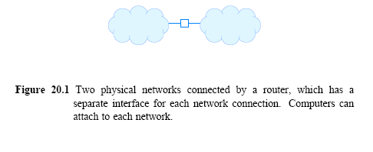
Physical Network Connection with Routers
The basic component used to connect heterogeneous networks is a router
Physically a router is
an independent hardware system dedicated to the task of interconnecting networks
contains a processor and memory as well as a separate I/O interface for each network to which it connects
Figure 20.1 illustrates that the physical connection of networks with a router is straightforward

Slide 13
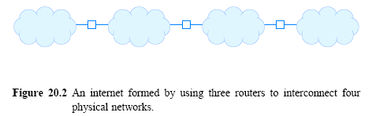
20.7 Internet Architecture
Organizations choose network technologies appropriate for each need
and to use routers to connect all networks
Figure 20.2 (below) illustrates how three routers can be used to connect four arbitrary physical networks into an internet

Slide 14
Achieving Universal Service
Routers must agree to forward information
The task is complex because
frame formats and addressing schemes used by the underlying networks can differ
Protocol software makes universal service possible
Later chapters describe Internet protocol software in detail
when written with an uppercase I, the term Internet refers to the current global Internet and the associated protocols
Internet protocols overcome differences in frame formats and physical addresses
to make communication possible among networks that use different technologies

Slide 15
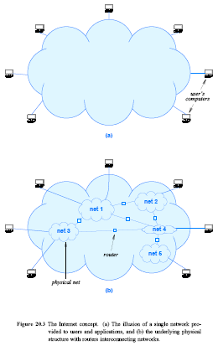
20.9 A Virtual Network
Figure 20.3 The Internet concept:
The illusion of a single network provided to users and applications
the underlying physical structure with routers interconnecting networks

Slide 16
20.10 Protocols for Internetworking
Several protocols have been proposed for use with internets
The TCP/IP Internet Protocol suite is the most widely used one
Networking professionals simply refer to the suite as TCP/IP
TCP and IP are acronyms for two of the most important protocols
TCP/IP was developed at the same time as the Internet
The same researchers who proposed TCP/IP also proposed the Internet architecture described above
Work on TCP/IP began in the 1970s
approximately the same time that LANs were being developed
Work continued until the early 1990s when the Internet became commercial

Slide 17
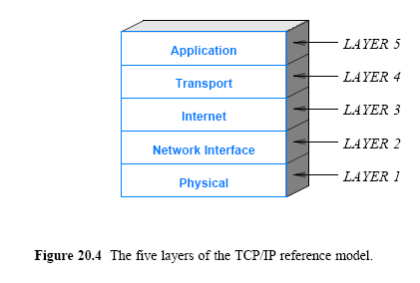
Review of TCP/IP Layering
Recall from Chapter 1 that the Internet protocols use a five-layer reference model as Figure 20.4 illustrates

Slide 18
Host Computers, Routers, and Protocol Layers
Host computer to refer to a computer that connects to the Internet and runs applications
A host can be as small as a cell phone or as large as a mainframe
a host's CPU can be slow or fast
the memory can be large or small
and the network can operate at high or low speed
TCP/IP protocols make it possible for any pair of hosts to communicate
despite hardware differences
Both hosts and routers need TCP/IP protocol software
However, routers do not use protocols from all layers
a router does not need layer 5 protocols
because routers do not run conventional applications

Slide 19
Chapter 21 IP: Internet Addressing

Slide 20
21.1 Introduction
This chapter
begins a description of protocol software that makes the Internet appear to be a single, seamless communication system
introduces the addressing scheme used by IP version 4 (IPv4)
Unless otherwise noted, Internet Protocol and IP refer to version 4 of IP throughout the text
discusses the use of address masks for classless and subnet addressing

Slide 21
History Of The Internet Protocol
IP separated from TCP in 1978
Version 1-3 discarded quickly; version 4 was the first version used by researchers
By early 1990s, a movement started that clamored for a new version of IP because the 32-bit address space would run out “soon”
In 1993, the IETF received proposals, and formed a working group to find a compromise
By 1995, a new version had been proposed and documents written

Slide 22
21.2 Addresses for the Virtual Internet
Addressing is a critical component of the Internet
All host computers must use a uniform addressing scheme
Each address must be unique
MAC addresses do not suffice because
the Internet can include multiple network technologies
and multiple types of MAC addresses
The advantage of IP addressing lies in uniformity:
new addressing scheme that is independent of MAC addresses being used
IP addresses are supplied by protocol software
They are not part of the underlying network
Many layers of protocol software use IP addresses

Slide 23
21.3 The IP Addressing Scheme
Each host is assigned a unique 32-bit number
known as the host's IP address or Internet address
When sending a packet across the Internet, sender’s protocol software must specify
its own 32-bit IP address (the source address)
and the address of the intended recipient (the destination address)

Slide 24
21.4 The IP Address Hierarchy
IP address is divided into two parts:
A prefix
identifies the physical network (locator)
Each network in the Internet is assigned a unique network number
A suffix
identifies a specific computer (host/node) on the network (identity)
Each computer on a given network is assigned a unique suffix
IP address scheme guarantees two properties:
Each computer is assigned a unique address
(i.e., a single address is never assigned to more than one computer)
Network number (prefix) assignments must be coordinated globally
Suffixes are assigned locally without global coordination

Slide 25
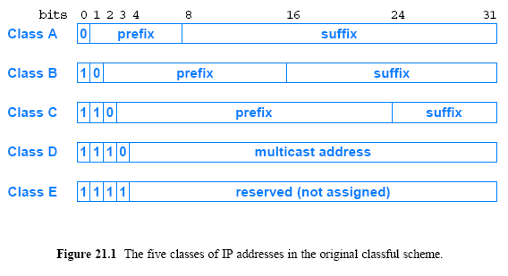
21.5 Original Classes of IP Addresses

Slide 26
21.6 Dotted Decimal Notation
A notation more convenient for humans to understand is used
Notation that has been accepted is
express each 8-bit section of a 32-bit number as a decimal value
use periods to separate the sections
The scheme is known as dotted decimal notation
Dotted decimal treats each octet (byte) as an unsigned binary integer
the smallest value, 0
occurs when all bits of an octet are zero (0)
the largest value, 255
occurs when all bits of an octet are one (1)
dotted decimal addresses range
0.0.0.0 through 255.255.255.255

Slide 27
21.7 Division of the Address Space
The classful scheme divided the address space into unequal sizes
The designers chose an unequal division to accommodate a variety of scenarios
For example, although it is limited to 128 networks, class A contains half of all addresses
The motivation was to allow major ISPs to each deploy a large network that connected millions of computers
Similarly, the motivation for class C was to allow an organization to have a few computers connected on a LAN

Slide 28
21.9 Subnet and Classless Addressing
As the Internet grew
the original classful addressing scheme became a limitation
Everyone demanded a class A or class B address
So they would have enough addresses for future growth
but many addresses in class A and B were unused
Many class C addresses remained, but few wanted to use them
Two mechanisms were invented to overcome the limitation:
Subnet addressing
Classless addressing
The two mechanisms are closely related
they can be considered to be part of a single abstraction:
instead of having three distinct address classes, allow the division between prefix/suffix on an arbitrary bit boundary

Slide 29
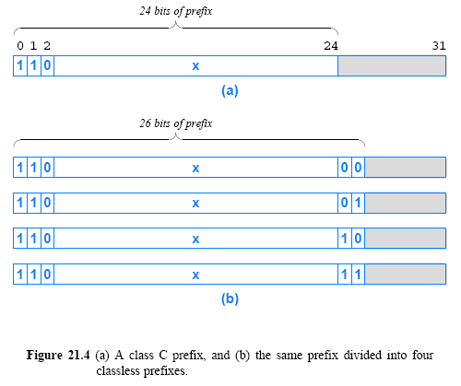
21.9 Subnet and Classless Addressing

Slide 30
21.10 Address Masks
Required with classless addressing
Associated with a network
Specifies division of addresses into network prefix and host suffix for that network
32-bit binary value
– 1-bits correspond to prefix
– 0-bits correspond to suffix
Example mask that specifies six bits of prefix
11111100 00000000 00000000 00000000

Slide 31
21.11 CIDR Notation
Classless Inter-Domain Routing (CIDR)
The name is unfortunate because CIDR only specifies addressing and forwarding
Used by humans to enter address mask
Avoids dotted decimal errors
Follows address with slash and integer X, where X is the number of prefix bits
Example
– In dotted decimal, a 26-bit mask is
255 . 255 . 255 . 192
– CIDR merely writes
/26

Slide 32
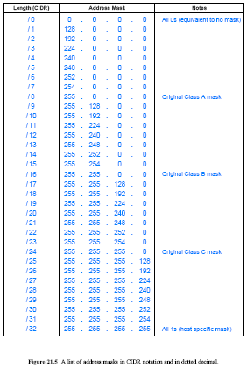
Figure 21.5
A list of address masks in CIDR notation and in dotted decimal

Slide 33
Why CIDR Is Useful
ISPs assign IP addresses
Corporate customer with N computers needs N addresses
CIDR permits ISP to round to nearest power of two
Example
– Assume ISP owns address block 128.211.0.0/16
– Customer has 12 computers
– ISP assigns 4 bits of suffix to customer
– Mask used is /28
– Example: customer is assigned 128.211.0.16/28
0001 0000
– Each computer at customer site has unique final 4 bits

Slide 34
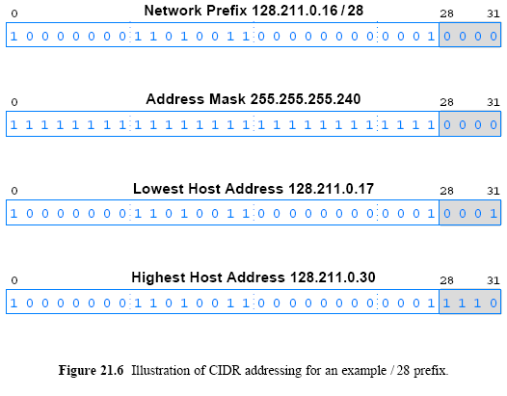
21.13 CIDR Host Addresses

Slide 35
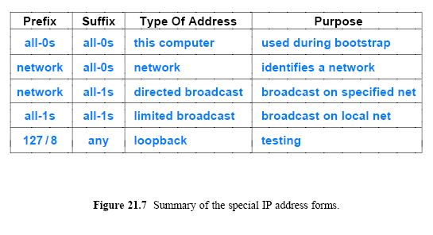
21.15 Summary of Special IP Addresses
Loopback address ( 127.0.0.1 ) used for testing
– Packets never leave the local host
Addresses 240.0.0.0/ 8 and above are multicast

Slide 36
Host Address Count
For a given network prefix, the all-0s and all-1s suffixes have special meaning
Consequence: if a suffix has N bits, 2^{N}− 2 hosts can be present
An IP address does not identify a specific computer. Instead, each IP address identifies a connection between a computer and a network.
host with multiple network connections is called a multi-homed host

Slide 37
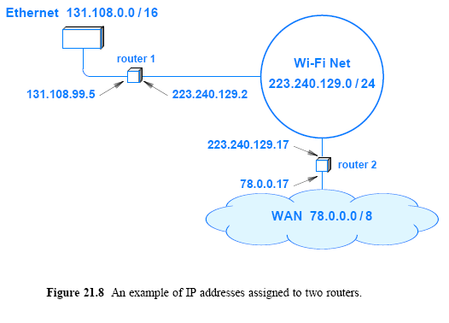
21.17 Routers and the IP Addressing Principle

Slide 38
Assignment
Will the Internet be replaced by a single networking technology? Why or why not?
2. If an ISP assigned you with a /28 address block(178.25.0.16/28), how many computers could you assign an address? Show the addresses assigned to computers.
3. Execute the following network commands, and find out the IP addresses of routers between your computer and www.google.com
tracert www.google.com
Send your solution to me by email. (Due date: 5.9. )
This assignment will be used to check your attendance.
© Pearson Education Inc., Upper Saddle River, NJ. All rights reserved.
38
Notes:
38

